Slide 1
Pass the Sugar, Please—Creating Opportunities for Staff to Have a Seat at the Table
Michele Haggar
Classified Senate President
Skyline College

Slide 2
Overview
Examining Myths
Leadership: Seeing what it looks like
Creating Leadership Opportunities
Suggested Reading

Slide 3
Learning Outcomes
You will understand how leadership is possible by examining misconceptions
You will learn several basic characteristics about a leader that will help you understand how to see yourself and others
You will learn how to approach creating leadership opportunities and have suggested reading for reference

Slide 4
Examining Myths

Slide 5
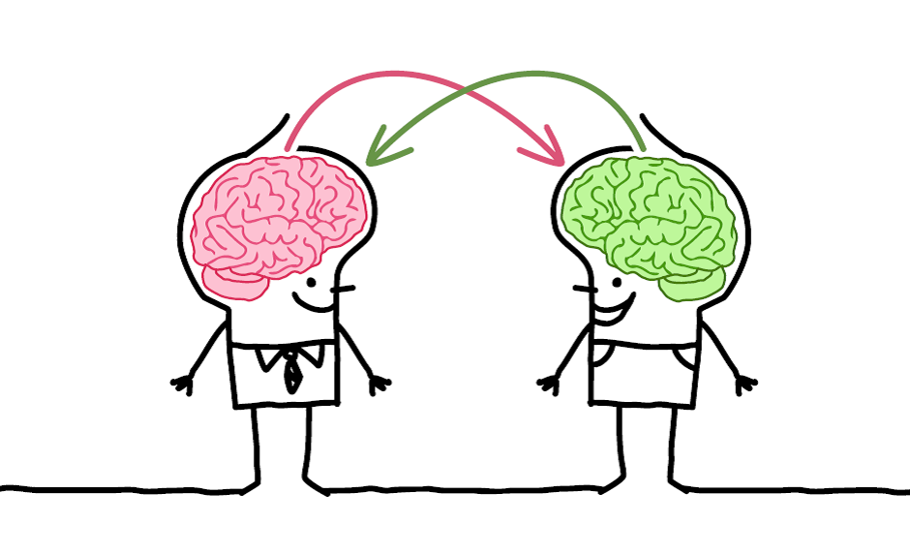
Myth 1: Classified Don’t Have a Seat at the Table
Step 1: Discuss whether you feel, at your campus, you feel Classified Staff don’t have a seat at the table? Share why or why not.
Step 2: Together, write down how you could address it on the “Activity Sheet”
Activity:

Slide 6
Myth 2: Classified Can’t Move Up the Ladder
Step 1: Discuss together if you agree with this statement. Why or why not?
Step 2: Write down why you think staff can or cannot move up the ladder.
Step 3: Write down solutions this problem (if you perceive it as a truth) on your activity sheet
Activity:

Slide 7
Myth 3: Classified don’t have time to step outside their office and attend senate meetings
Step 1: Discuss together if, on your campus, you would say this statement is true? Why or why not?
Step 2: Write down reasons you think staff can or cannot step outside their office
Step 3: Write down solutions this problem (if you perceive it as a truth) on your activity sheet
Activity:

Slide 8
Leadership: Seeing what it looks like

Slide 9
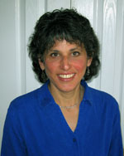
Truth: A Leader Recognizes Equity and Inclusivity
“The Tapestry Model (TM) uses the metaphor of weaving a tapestry to illuminate some of the main tenets of an intersectional framework and other aspects of how people experience social identities within larger systems of structural inequality.”
“The Tapestry Model: Exploring Social Identities, Privileges, and Oppression from an intersectional Perspective”
By Dr. Diane J. Goodman

Slide 10
“One’s tapestry is made up of different colored threads, each thread reflecting different social identities and corresponding privileges or oppression…the whole tapestry is multicolored, since people always embody all their identities.”

Slide 11
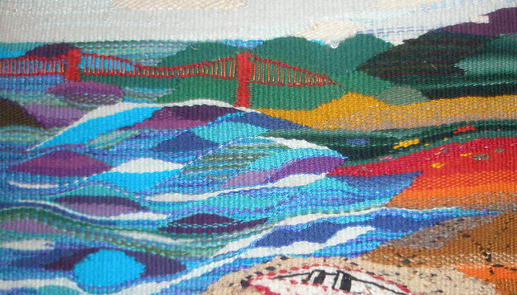
What everyone sees…

Slide 12
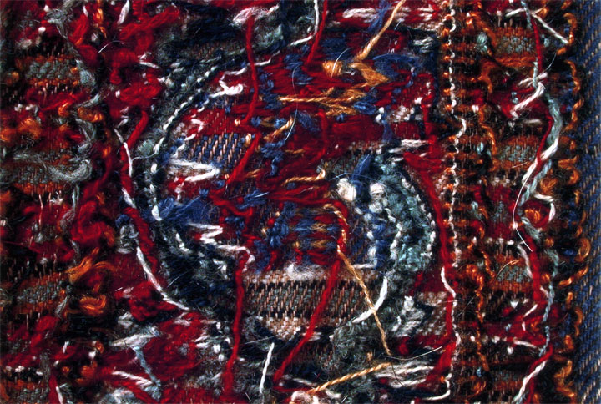
What we experience, but others don’t see

Slide 13
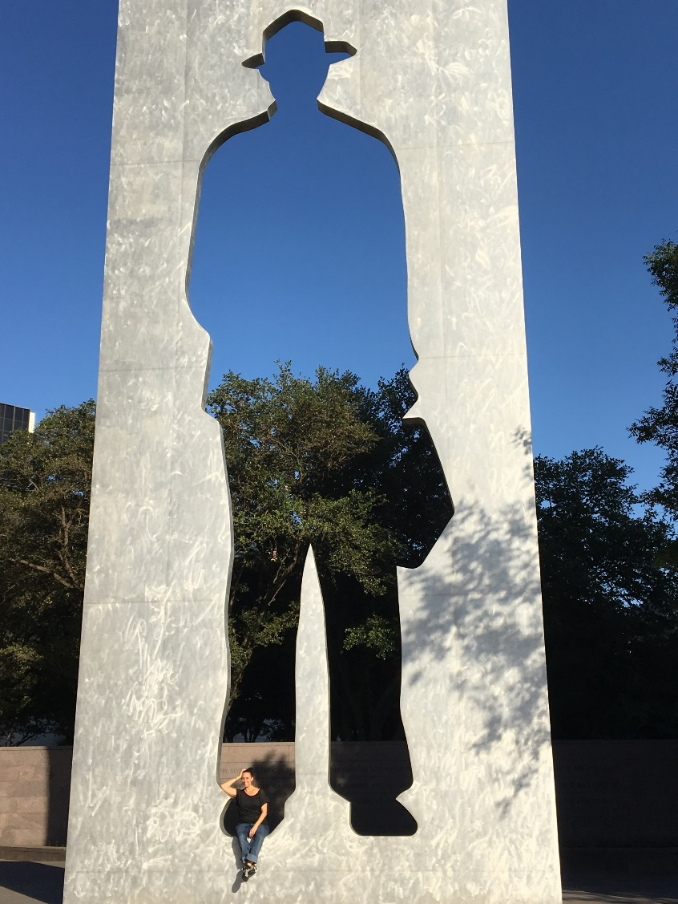
How does the Tapestry model relate to my work?
Self-Awareness
Understanding and valuing others
Process of Cultural Consciousness
Knowledge of other societal inequalities
Cultural Desire (a desire to foster equity and inclusion)
Cultural Encounters
Notes:
Cultural awareness is defined as the process of conducting a self-examination of one’s own biases towards other cultures and the in-depth exploration of one’s cultural and professional background. Cultural awareness also involves being aware of the existence of documented racism and other “isms”.
Cultural knowledge is defined as the process in which the professional seeks and obtains a sound educational base about culturally diverse groups.
Cultural skill is the ability to conduct a cultural assessment to collect relevant cultural data regarding the client’s presenting problem as well as accurately conducting a culturally-based physical assessment.
Cultural encounters is the process which encourages the professional to directly engage in face-to-face cultural interactions and other types of encounters with clients from culturally diverse backgrounds in order to modify existing beliefs about a cultural group and to prevent possible stereotyping. It is also the pivotal construct of cultural competence that provides the energy source and foundation for one’s journey towards cultural competence's: is defined as the process of conducting a self-examination of ones own biases towards other cultures and the in-depth exploration.
Cultural desire is the motivation of the healthcare professional to “want to” engage in the process of becoming culturally aware, culturally knowledgeable, culturally skillful and seeking cultural encounters; not the “have to.”

Slide 14
Truth: Leaders are…
*Have the responses you provided on your “Activity Sheet” out as we discuss this slide
Communicators
Trustworthy
Visible
Collaborators with a strong voice
People who work to establish relationships
Seeking out personal development opportunities
Not afraid to admit failures or ask for help

Slide 15
Creating Leadership Opportunities

Slide 16
Connecting Classified to Administrators and the Campus
Establishing a Statement of Ethics
Work closely with Academic Senate
Professional Mentorship Program
Guided Pathways and Meta Majors Open Forums
Attend conferences (CLI and NCORE) and create a link on your site for staff to find/ access information
Poll your staff to see what types of on-campus PD opportunities they want to see
Retreats for Classified Staff
Developing an agenda that helps connect staff to initiatives/ efforts on campus
Develop a resolution around Professional Development, Equity, and Inclusiveness
Classified Senate Senators

Slide 17
Suggested Reading

Slide 18
Summer Reading/ Viewing List…
Read:
The Tapestry Model By Dr. Jane J. Goodman
Why Aren’t We There Yet? Taking Personal Responsibility for Creating an Inclusive Campus Edited by Jan Arminio, Vastu Torres, and Rachele L. Pope
Multiculturalism on Campus: The Theory, Models, and Practices for Understanding Diversity and Creating Inclusion Edited by Michael J. Cujet, Mary F. Howard-Hamilton, and Diane L. Cooper.
Insiders Guide to Community College Administration by Robert Jensen
Emotional Intelligence 2.0 by Travis Bradberry, Jean Greaves
Leadership 2.0 By Travis Bradberry, Jean Greaves
7 Habits of Highly Effective People by Stephen Covey
Watch:
Mele Murals (link provided in Power Point Presentation)

Slide 19
Questions?
THANK YOU
Michele Haggar
E: haggarm@smccd.edu
Ph: (650)738-7026

